Slide 1
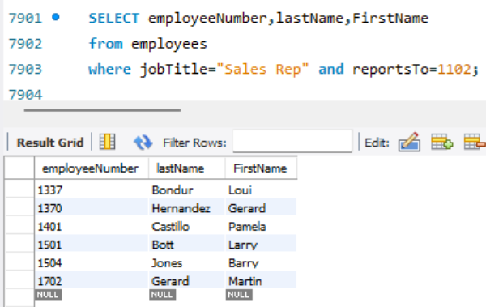
Q.1. Fetch the employee number, first name and last name of those employees who are working as Sales Reps reporting to the employee with employee number 1102 (Refer to employee table).

Slide 2
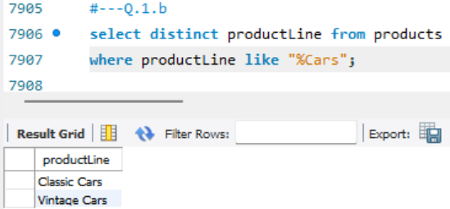
Q.2. Show the unique product line values containing the word cars at the end from the products table.

Slide 3
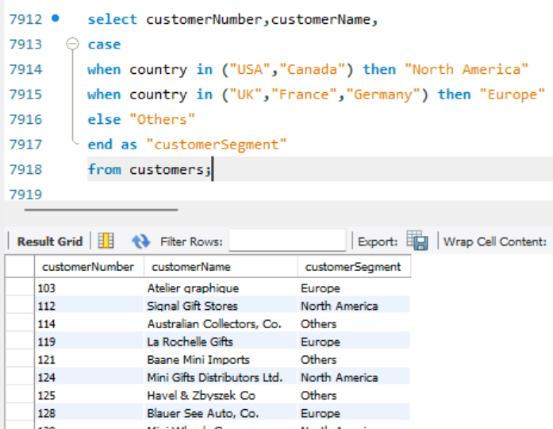
Q.3. Using a CASE statement, segment customers into three categories based on their country:(Refer Customers table) "North America" for customers from USA or Canada” , "Europe" for customers from UK, France, or Germany” "Other" for all remaining countries”, Select the customer number, customer name, and the assigned region as "CustomerSegment".

Slide 4
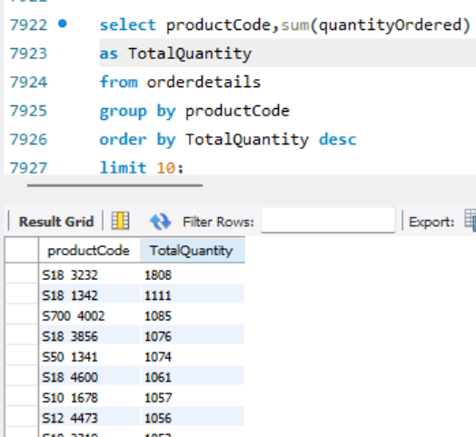
Q.4. Using the OrderDetails table, identify the top 10 products (by productCode) with the highest total order quantity across all orders.

Slide 5
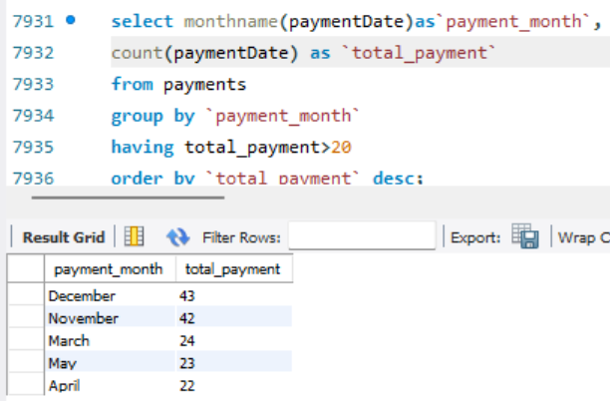
Q.5..Company wants to analyse payment frequency by month. Extract the month name from the payment date to count the total number of payments for each month and include only those months with a payment count exceeding 20. Sort the results by total number of payments in descending order. (Refer Payments table).

Slide 6
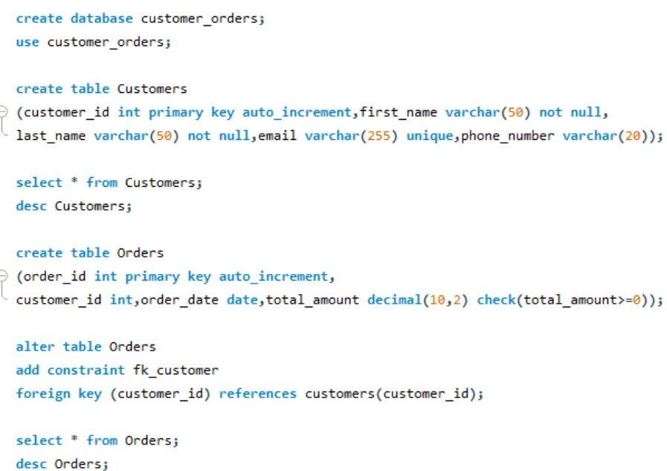
Q.6.a.Create a table named Customers to store customer information. Include the following columns: customer_id: This should be an integer set as the PRIMARY KEY and AUTO_INCREMENT. first_name: This should be a VARCHAR(50) to store the customer's first name. last_name: This should be a VARCHAR(50) to store the customer's last name. email: This should be a VARCHAR(255) set as UNIQUE to ensure no duplicate email addresses exist. phone_number: This can be a VARCHAR(20) to allow for different phone number formats. Add a NOT NULL constraint to the first_name and last_name columns to ensure they always have a value

Slide 7
Q.6.b. Create a table named Orders to store information about customer orders. Include the following columns: order_id: This should be an integer set as the PRIMARY KEY and AUTO_INCREMENT. customer_id: This should be an integer referencing the customer_id in the Customers table (FOREIGN KEY). order_date: This should be a DATE data type to store the order date. total_amount: This should be a DECIMAL(10,2) to store the total order amount. Constraints: Set a FOREIGN KEY constraint on customer_id to reference the Customers table. Add a CHECK constraint to ensure the total_amount is always a positive value.

Slide 8
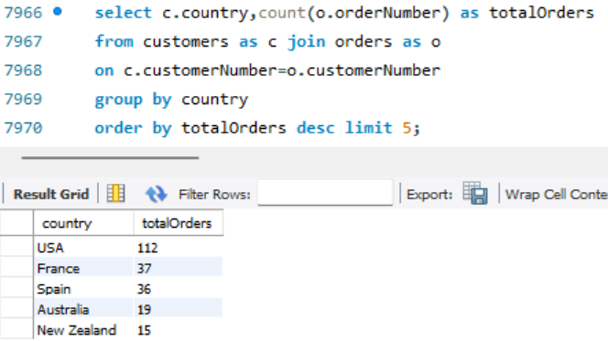
Q.7. List the top 5 countries (by order count) that Classic Models ships to. (Use the Customers and Orders tables)

Slide 9
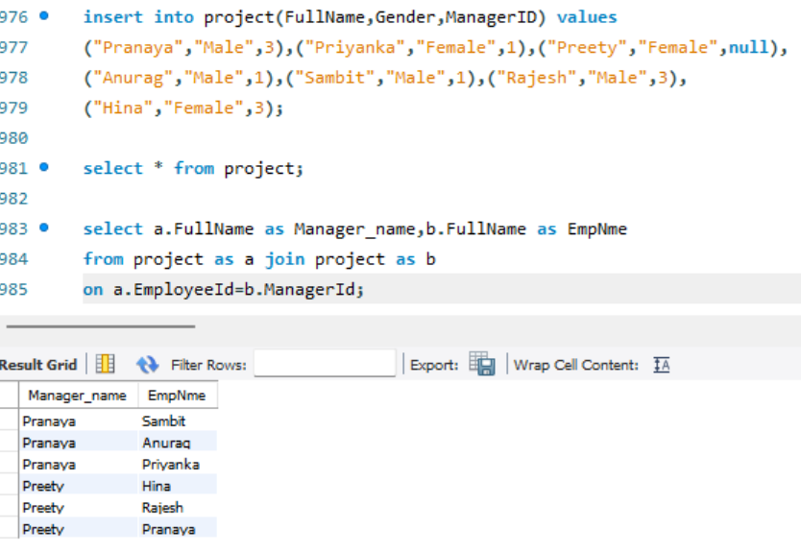
Q.8. Create a table project with the below fields. EmployeeID: integer set as the PRIMARY KEY and AUTO_INCREMENT. FullName: varchar(50) with no null values Gender: Values should be only ‘Male’ or ‘Female’ ManagerID: integer

Slide 10
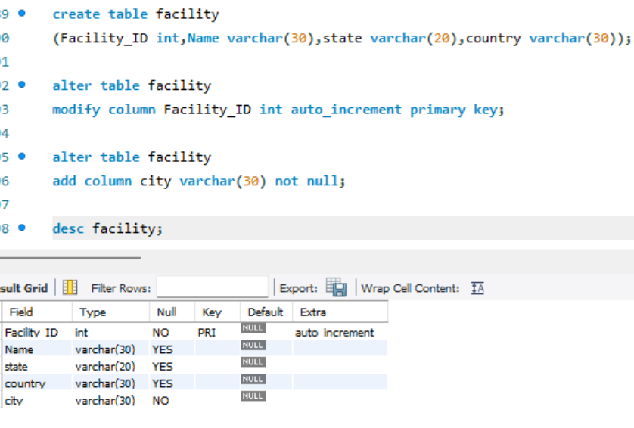
Q.9. Create table facility. Add the below fields into it. Facility_ID,Name,State,Country i) Alter the table by adding the primary key and auto increment to Facility_ID column. ii) Add a new column city after name with data type as varchar which should not accept any null values.

Slide 11
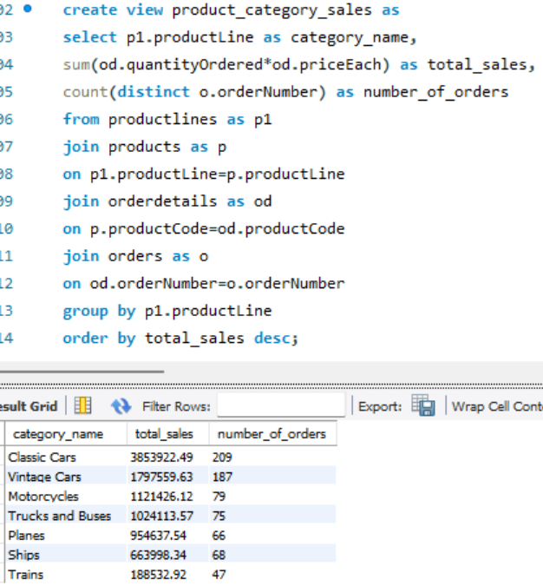
Q.10 Create a view named product_category_sales that provides insights into sales performance by product category. This view should include the following information: productLine: The category name of the product (from the ProductLines table). total_sales: The total revenue generated by products within that category (calculated by summing the orderDetails.quantity * orderDetails.priceEach for each product in the category). number_of_orders: The total number of orders containing products from that category. (Hint: Tables to be used: Products, orders, order details and product lines)

Slide 12
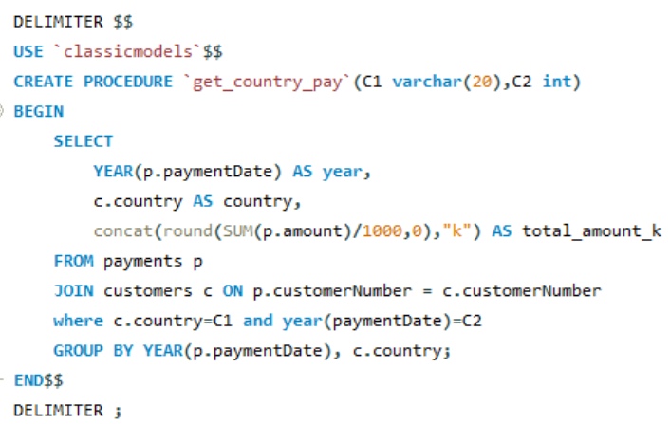

Q.11. Create a stored procedure Get_country_payments which takes in year and country as inputs and gives year-wise, country-wise total amount as an output. Format the total amount to nearest thousand units (K) Tables: Customers, Payments

Slide 13
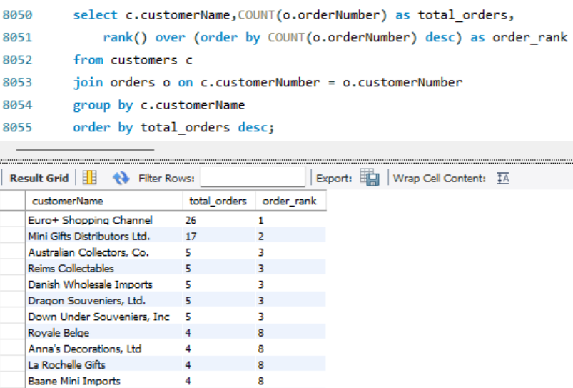
Q.12. Using customers and orders tables, rank the customers based on their order frequency

Slide 14
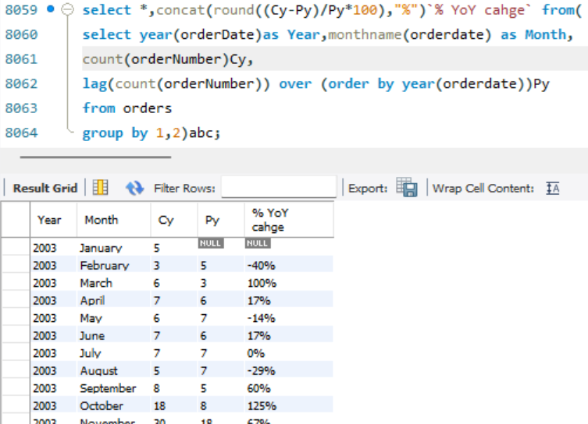
Q.13. Calculate year-wise, month-name-wise count of orders and year-over-year (YoY) percentage change. Format the YoY values in no decimals and show them in % sign.

Slide 15
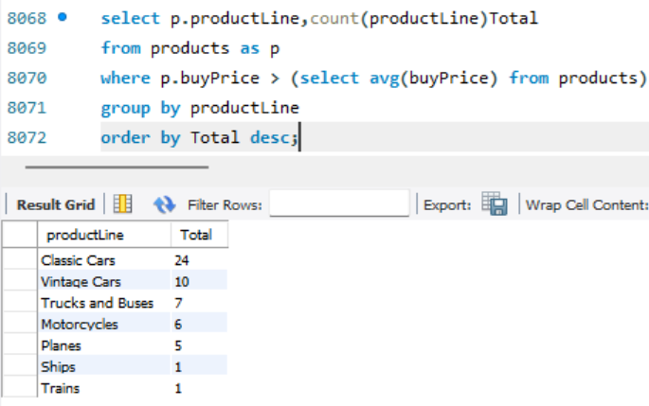
Q.14. Find out how many product lines are there for which the buy price value is greater than the average of buy price value. Show the output as product line and its count.

Slide 16
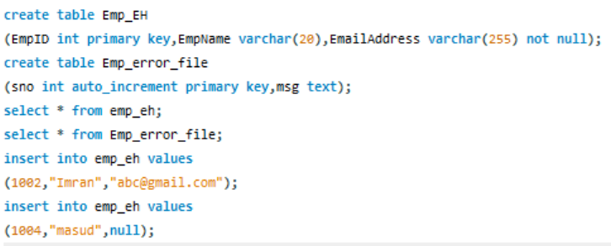
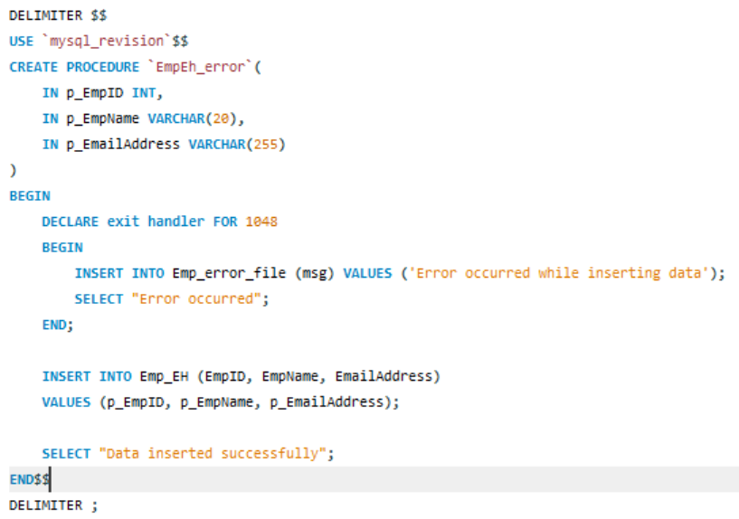
Q.15. Create the table Emp_EH. Below are its fields. EmpID (Primary Key),EmpName, EmailAddress, Create a procedure to accept the values for the columns in Emp_EH. Handle the error using the exception handling concept. Show the message as “Error occurred” in case of anything is wrong.

Slide 17
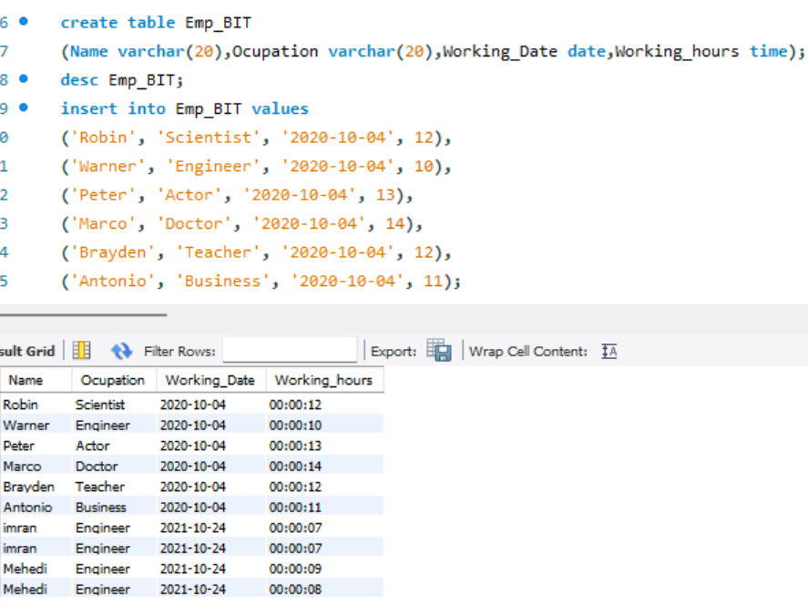
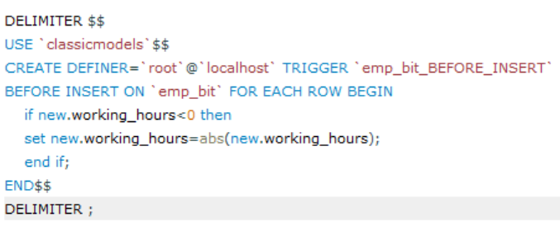
Q.16. Create the table Emp_BIT. Add the below fields in it. Name, Occupation, Working_date, Working_hours Create before insert the trigger to make sure any new value of Working_hours, if it is negative, then it should be inserted as positive.

